Slide 1
PinkBox
By: Aarithi Rajendren, Lara Afont, Erriana Thomas, Isabelle Carminati
An Application for Movie Lovers

Slide 2
Overview
1
2
3
Introductions
Kanban Board
Sprint 1 Accomplishments
4
5
6
User Authentication Demo
Software Tests & Backend
Sprint 2 Backlog
Group Members and their role on the team
A review of our project tasks and agenda
Our completed tasks for Sprint 1
A live demo of PinkBox’s login and sign up
Display of our Backend APIs and Software Tests
Sprint 2 Goals, Issues & Next steps

Slide 3
01.
Introductions

Slide 4
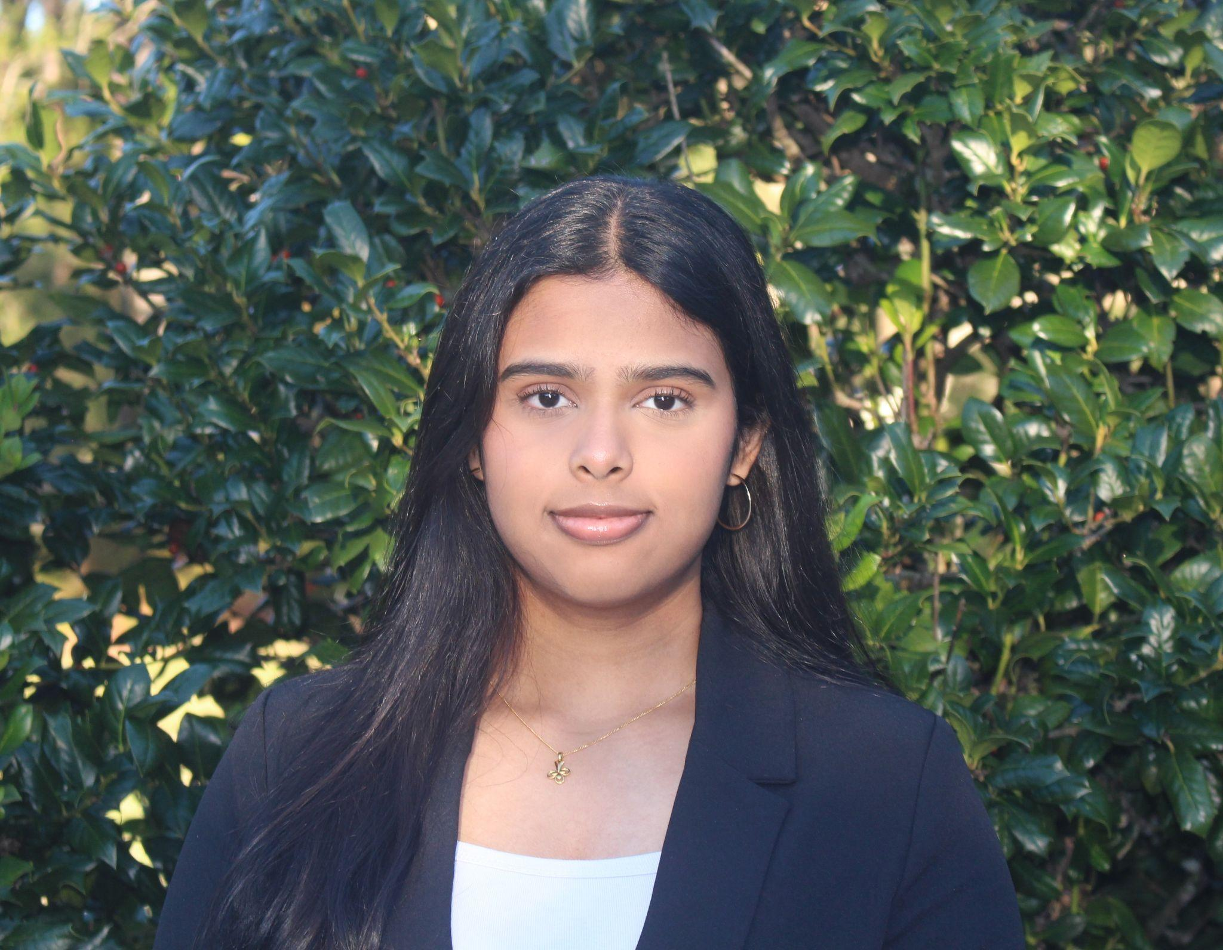
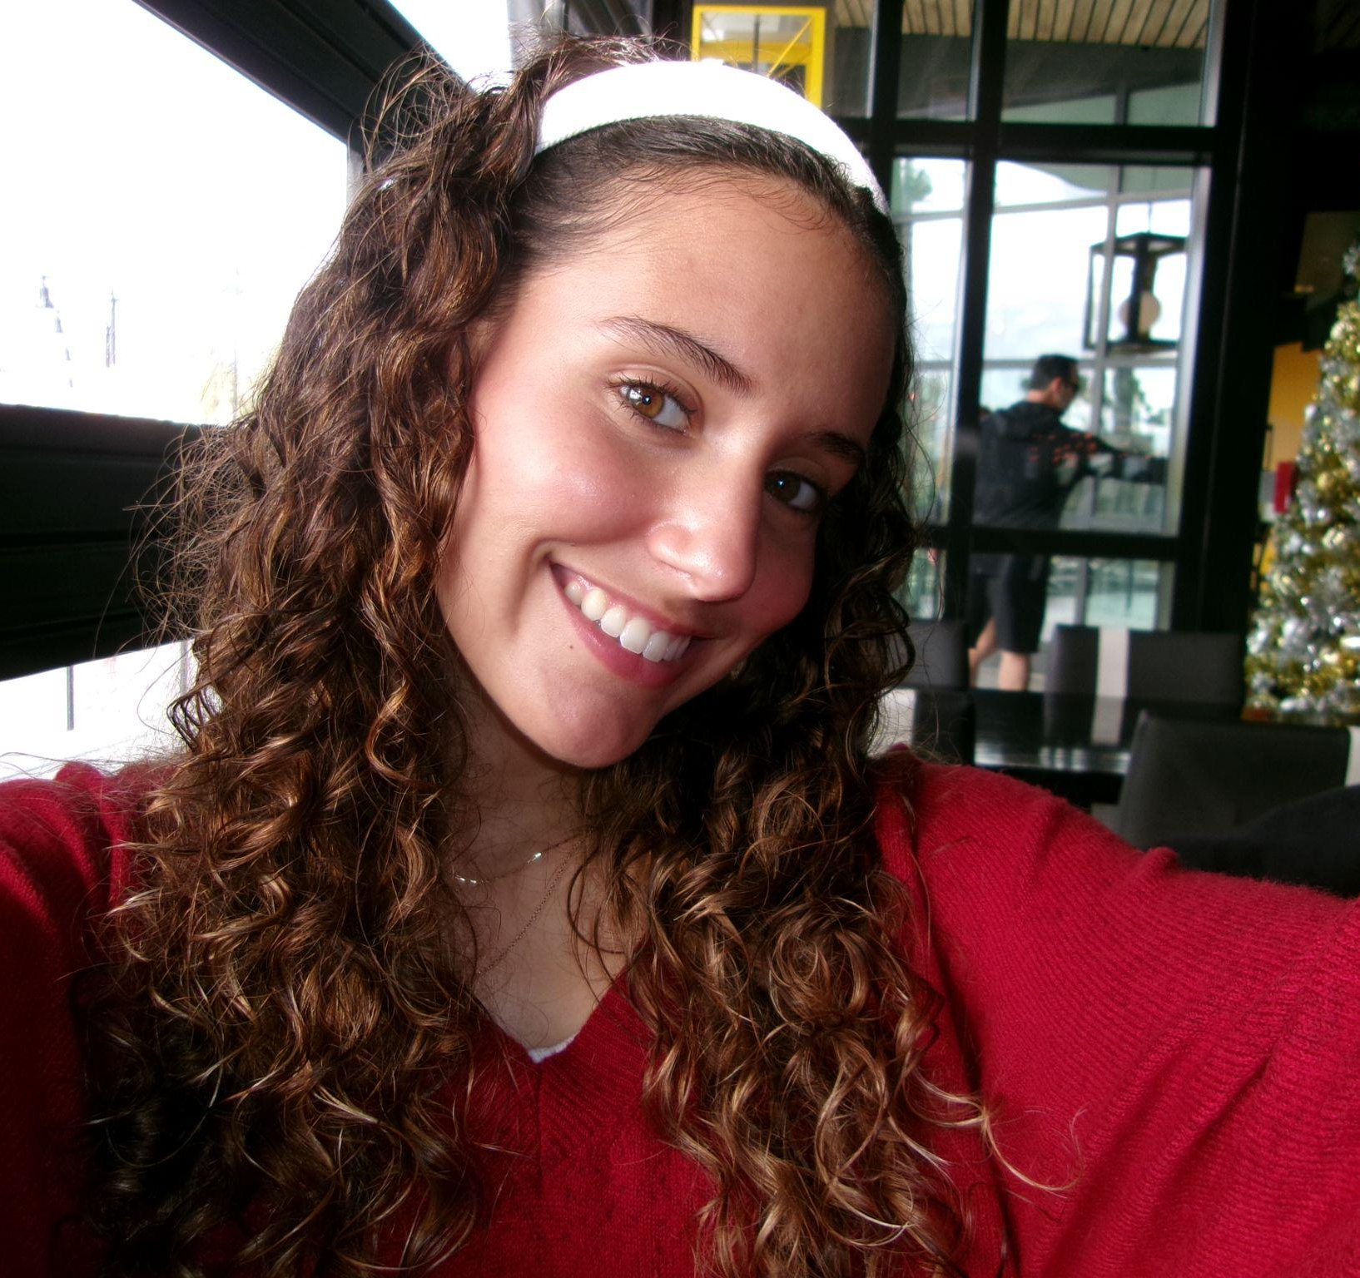

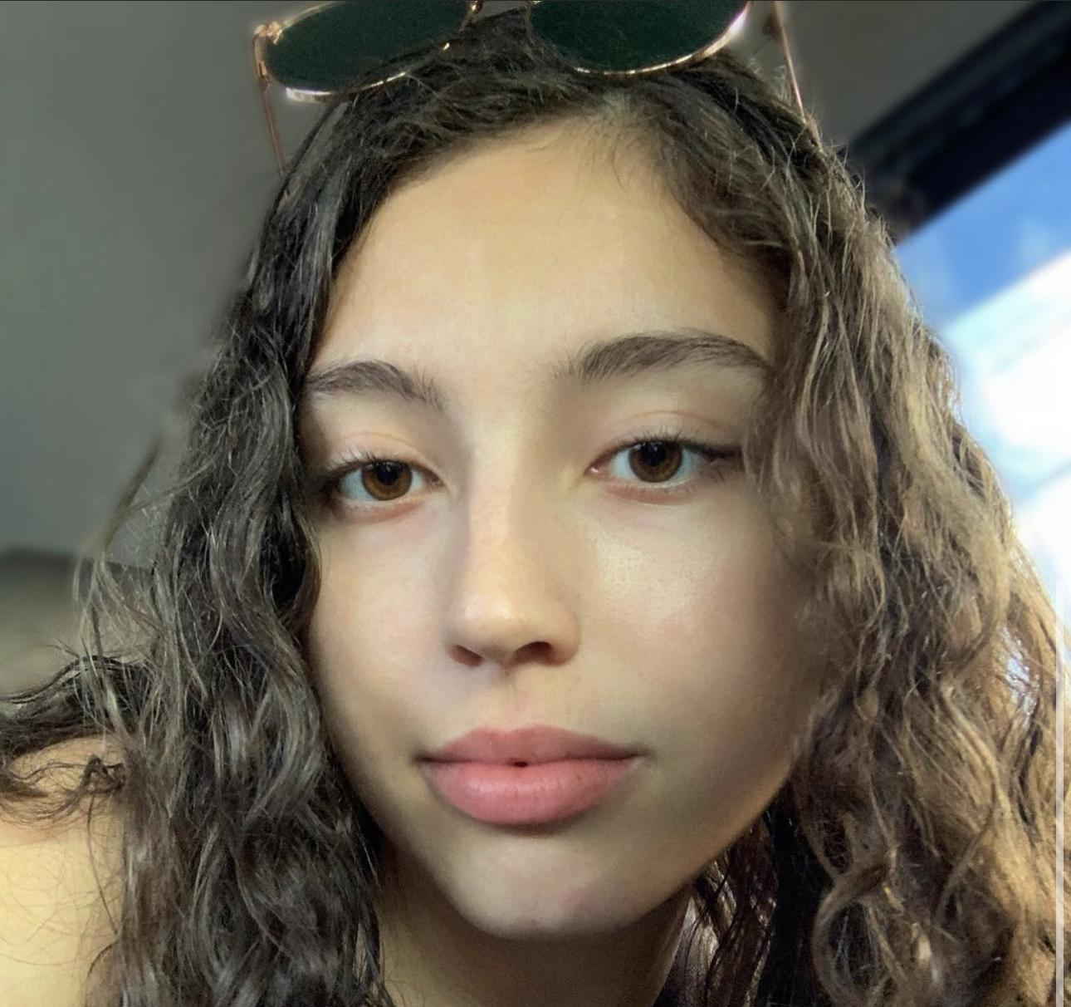
Our Team
Aarithi Rajendren
Lara Afont
Erriana Thomas
Isabelle Carminati
Back-end Developer
Back-end Developer
Front-end Developer
Front-end Developer

Slide 5
02.
Kanban Board
Project tasks & Agenda

Slide 6
03.
Sprint 1 Accomplishments
Backlog achievements
Notes:
Lara will introduce this section

Slide 7
Completed Sprint 1 Backlog
Issues | Roles
Movie + User Databases | Lara, Aarithi
APIs Established (login, signup) | Lara, Aarithi
User Authentication | Isabelle, Erriana
Page Navigation | Isabelle, Erriana
Notes:
Lara: our databases are set up, including the movie and users databases, which were the most important databases to get our website to start functioning. because our APIs like login and signup and much of our foundational backend is completed, user authentication was able to be fully fleshed out. There is a log in page that allows users to log in if they already have an account with us. If not there is a sign up link which lets users create an account and have their information immediately added to our database. There is testing for incorrect username/password if users input the wrong information. We have also created many different pages on our website for navigation sake and usability, these pages include “home”, “movies”, “wishlist”, “cart”, and “login”. There is still nothing displayed on most of these pages, but the pages and navigation is working for users. All of these features will be demonstrated in our live demo

Slide 8
04.
Live Demo!
Notes:
Erriana’s slide

Slide 9
05.
Software Tests & Display of Backend
Review of Software Tests

Slide 10
Software Tests & Backend APIs
Issues | Demo on Backend
Product Filtering | Filter movies by genre
Search Movies | Search for a movie by its title
Shopping Cart Modification | Add and remove movies from cart - only if a user
Display Movie Information | Display all movies and their respective information

Slide 11
06.
Sprint 2 & Next Steps
Review of Sprint 2 Backlog
Notes:
Lara will introduce this section

Slide 12
Sprint 2 Backlog Plans
Issues | Roles
Displaying Movie Content | Isabelle, Erriana
Cart Checkout Functionality | Lara, Aarithi, Isabelle, Erriana
Wishlist API/Functionality | Lara, Aarithi
User Purchase Confirmation | Isabelle, Erriana
Notes:
Lara: For our Sprint 2 backlog plans, we will focus on displaying the information on our pages, such as putting the movie information posters, titles, and everything on our pages. We will add the ability to add movies to the users cart by implementing the frontend and backend connection and follow through with the purchasing process so that users get their mp4 files emailed to them. We also will add a wishlist feature so our users can tag movies that they plan to purchase in the future.

Slide 13
Sprint 2: Issues & Next Steps
1.
2.
3.
4.
Building each page (home, cart etc.) with necessary content
Customizing user interface (to make it more engaging)
Implementing the Wishlist feature
Transaction functionality (“buying” the product)

Slide 14
1.
We’ll be implementing the following pages:
Home
Movies
Wishlist
Cart
Building Each Page
Notes:
Explain each page

Slide 15
2.
This portion is centered around the frontend team.
Aesthetic & Color Palette
Figma
Interactions through visuals
Customizing User Interface
Notes:
Explain each page

Slide 16
3.
Feature where you can “heart” certain movies to add onto your wishlist.
Working wishlist page
Move to cart feature
Updated throughout the website
Wishlist Feature
Notes:
Explain each page

Slide 17
4.
Where users can actually purchase items.
Functional cart page
Checkout option
Email product & confirmation
Transaction Functionality
Notes:
Explain each page

Slide 18
Thank You!

